Slide 1

CET2009B: Mini Project A.Y. 2023-24 Semester: VI
Third Year B. Tech. CSE (Cybersecurity and Forensics)
Department of Computer Engineering and Technology
Mini Project Topic Approval Presentation Topic: Attendence Assistant
Group Id: A1
PA10. Krishnaraj Thadesar - 1032210888 PA07. Parth Zarekar - 1032210846 PA25. Sourab Karad - 1032211150 PA24. Saubhagya Singh - 1032211144

Slide 2
Content
Project Introduction
Aim
Objectives
Motivation
Problem Statement
Literature Review
Research Gaps Identified / Implementation Scope
Hardware and Software Requirements
Proposed System Architecture / Block Diagram
Proposed Methodology/ Algorithm
References

Slide 3
Project Introduction
The "Attendance Assistant" presents a forward-thinking solution for revolutionizing conventional attendance tracking in educational settings. Integrating cloud services such as Amazon S3, Amazon EC2, and Amazon DynamoDB with the official Raspberry Pi High-Quality Camera, the project offers a sophisticated hybrid architecture for efficient and scalable face recognition capabilities.
The "Attendance Assistant" represents a significant leap towards modernizing attendance tracking processes. By adopting a hybrid architecture that blends the strengths of cloud services with edge computing, the project offers flexibility and scalability, catering to the evolving demands of attendance management in educational institutions.

Slide 4
Aim
Implement an Automated Attendance Tracking System at our Campus using computer vision, cloud infrastructure, and advanced data science techniques. The goal is to streamline attendance management, reduce manual tracking time, and enhance overall efficiency while ensuring security and tamper resistance.

Slide 5
Objectives
Develop an automated attendance tracking system using computer vision for any organization
Utilize cloud infrastructure for efficient storage and processing of attendance data.
Create a user-friendly application for both teachers and students to simplify attendance management.
Implement advanced data science techniques for processing large attendance datasets and performing analytics.
Significantly reduce per-class time spent on attendance tracking through automated processes, enhancing overall efficiency.
Mitigate the risk of malpractices in attendance tracking by implementing secure and tamper-resistant mechanisms.

Slide 6
Motivation
Time taken to take attendance is about 5 minutes in each class. That amounts to around 5 times 6 which is 30 minutes wasted each day per class. For 2 CSF, 2 AI, and 1 CSBS, and 8 CSE Panels, 13 panels for CSE alone waste more than 13 x 30 = 390 Minutes, which is more than 6 hours daily, just marking attendance.
This amounts to 6 Hours * 5 * 4 * 10 = 1200 Hours per year just for CSE (50 Days) or 2 months
Even after all that time, several more hours are spent on arguments, discussions and manual entry and marking by teachers and students, just for attendance. We do not find this an ideal use of time, and would like to combat this.
Malpractices still happen despite of all efforts and time spent. Attendance is mismarked by human error as well. We aim to reduce this error.

Slide 7
Problem Statement
Manual attendance tracking at MITWPU Campus is a time-consuming process prone to inefficiencies and potential malpractices. The current system lacks automation, leading to increased per-class time spent on attendance management.
To address these challenges, there is a need for the development of an Automated Attendance Tracking System. The solution should leverage computer vision for accurate data capture, utilize cloud infrastructure for efficient storage and processing, and incorporate advanced data science techniques for analytics.
The system should be user-friendly, providing both teachers and students with a seamless experience while ensuring security and tamper resistance to mitigate the risk of malpractices in attendance tracking. The goal is to enhance overall efficiency and significantly reduce the manual effort involved in attendance monitoring.

Slide 8
Literature Review
Several Research Papers like the ones mentioned below were referred.
The gaps between their implementations and our implementations were noted.
The gaps in Pricing were also noted.
These observations are shown in successive slides.

Slide 9
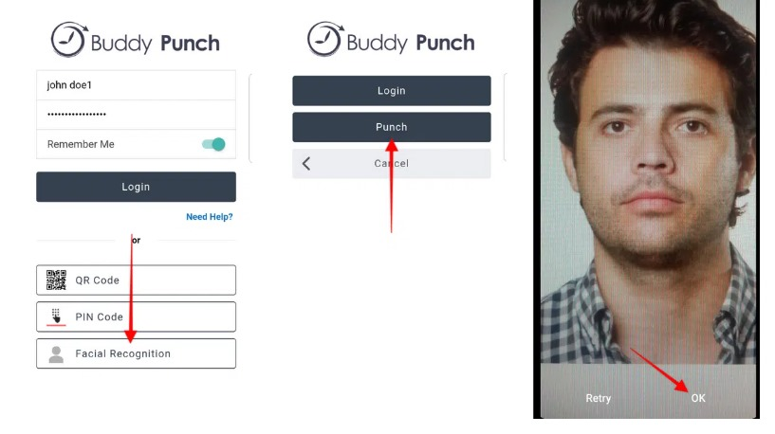
Existing Products in Market and Cost Comparison

Slide 10
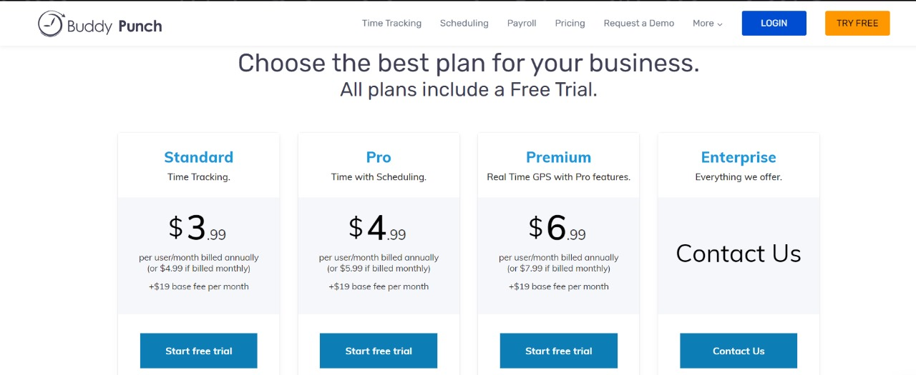

Slide 11
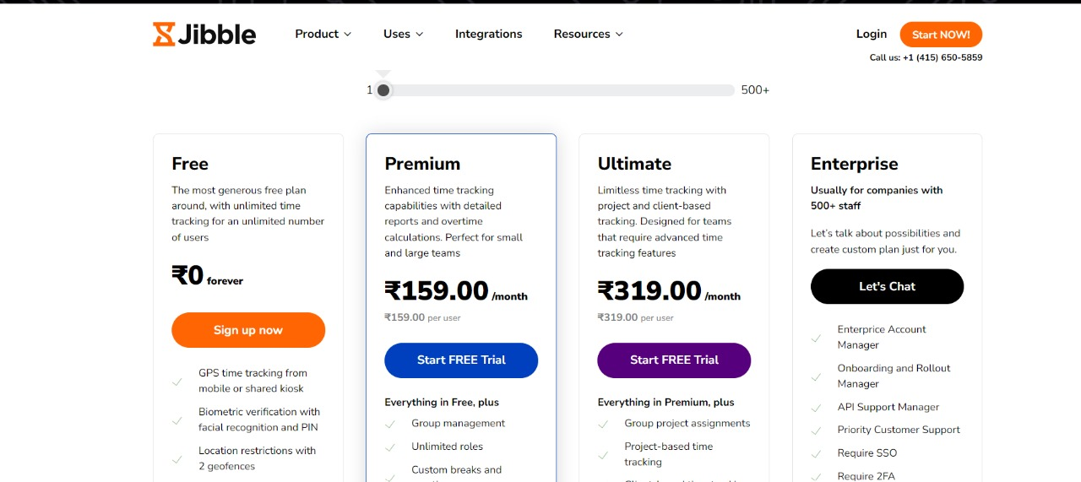
Cost Comparison

Slide 12
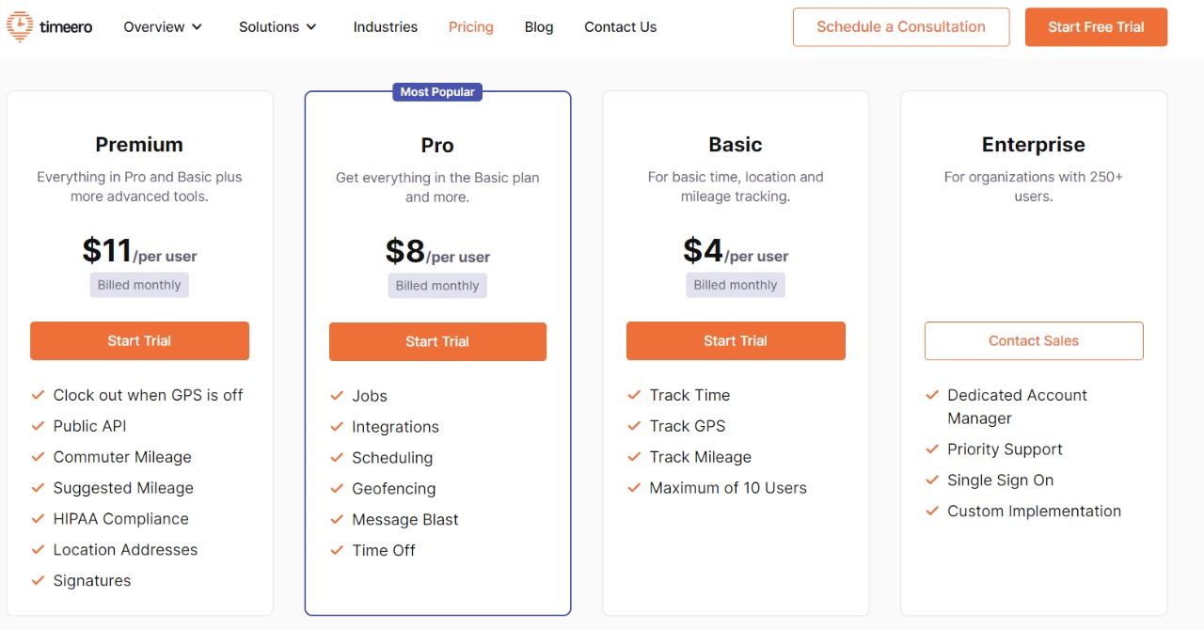

Slide 13
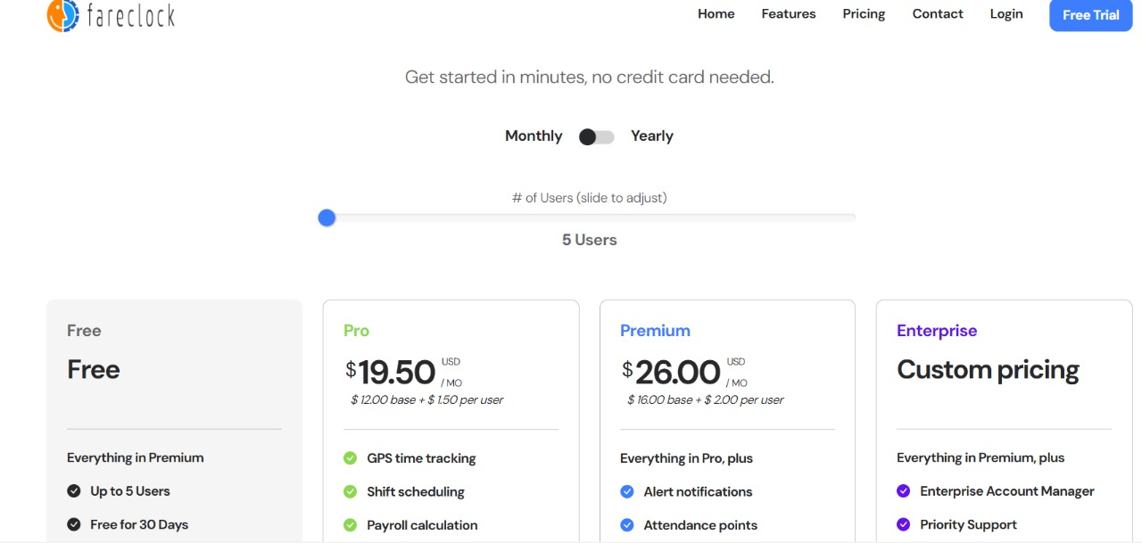

Slide 14
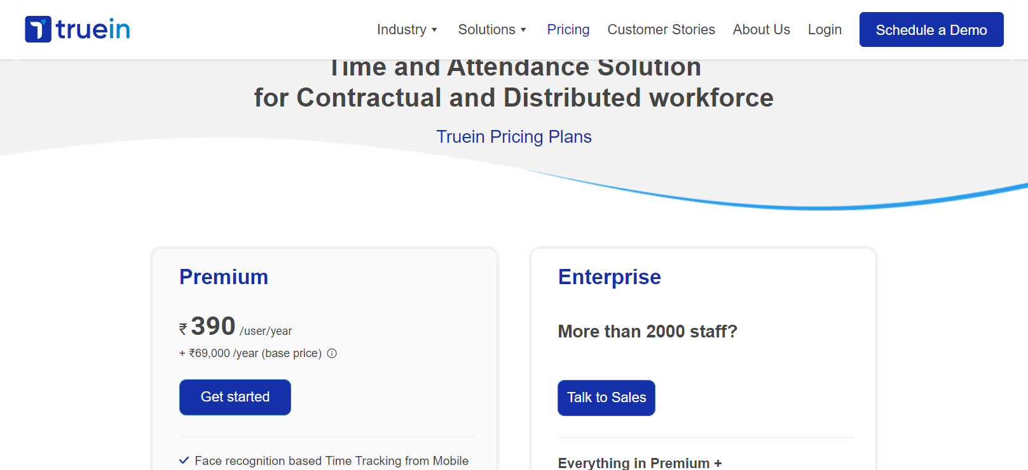

Slide 15
Existing Market Competitors
Buddy Punch
Timeero
FareClock
Jibble
QuickBooks

Slide 16
Research Gaps Identified / Implementation Scope
Gap 1: Lack of Specific Facial Recognition Libraries and Models Documentation
Existing literature fails to provide a comprehensive overview of specific facial recognition libraries and models. The omission of detailed discussions on these crucial components hinders a holistic understanding of the technological landscape.
Gap 2: Absence of Hardware Elements Documentation
A significant gap is identified in the absence of detailed documentation regarding the hardware elements employed. The current body of work overlooks crucial insights into the hardware aspects, limiting the understanding of the complete facial recognition system.
Gap 3: Insufficient Information on Interlinking Hardware and Software
The interplay between hardware and software components is a critical aspect of facial recognition systems. However, the existing literature lacks substantial information on how these elements are intricately interlinked, hindering a comprehensive grasp of the system's architecture.

Slide 17
Gap 4: Inadequate Details on Storage and Integration of Information
The literature review reveals a gap in information pertaining to the storage and seamless integration of facial recognition data. Understanding the mechanisms for data storage and integration is essential for evaluating the system's overall efficiency, and this aspect requires further exploration.
Gap 5: Lack of Seamless Integration
The current research landscape highlights a significant gap concerning the seamless integration of services. Notably, existing systems rely on manual user initiation, requiring individuals to independently open dedicated services on their personal devices. This operational hurdle indicates a crucial area for improvement in achieving a more streamlined and user-friendly experience. Addressing this gap is paramount for enhancing the overall efficiency and user adoption of the services, warranting further exploration and innovation in the integration protocols employed.

Slide 18
Hardware Requirements
Name | Purpose | Cost
Raspberry Pi Hi Quality Camera | Official camera from Raspberry Pi, more expensive for High resolution. | 8000
Raspberry Pi Camera Module 3 | Official camera from Raspberry pi, cheaper and highest resolution for cheapest cost. | 3000
Raspberry PI 4 Model B with 2 GB RAM | To send image from camera to server. | 5000

Slide 19
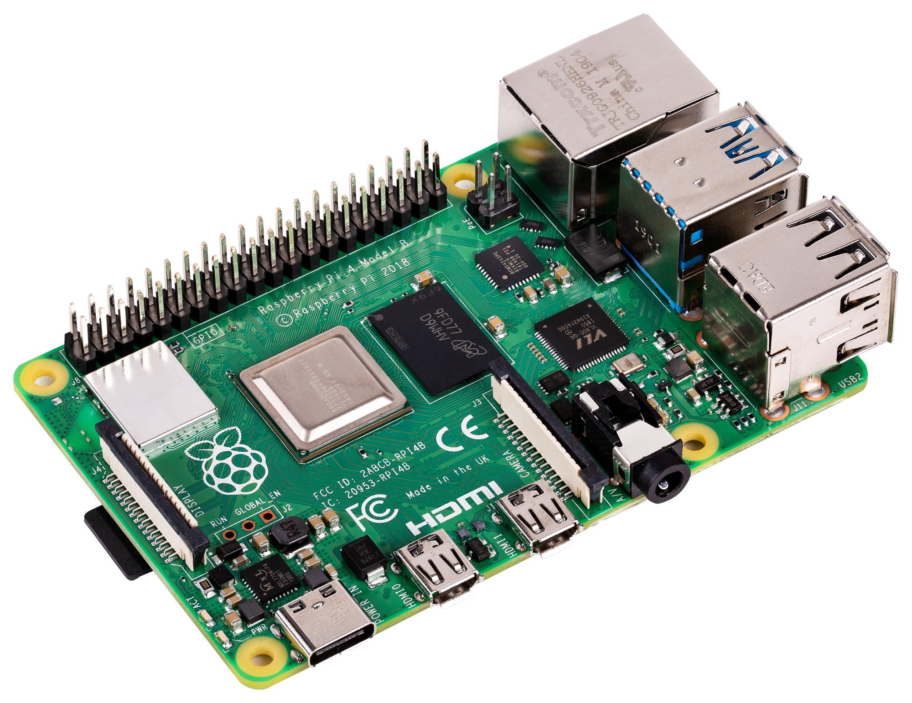
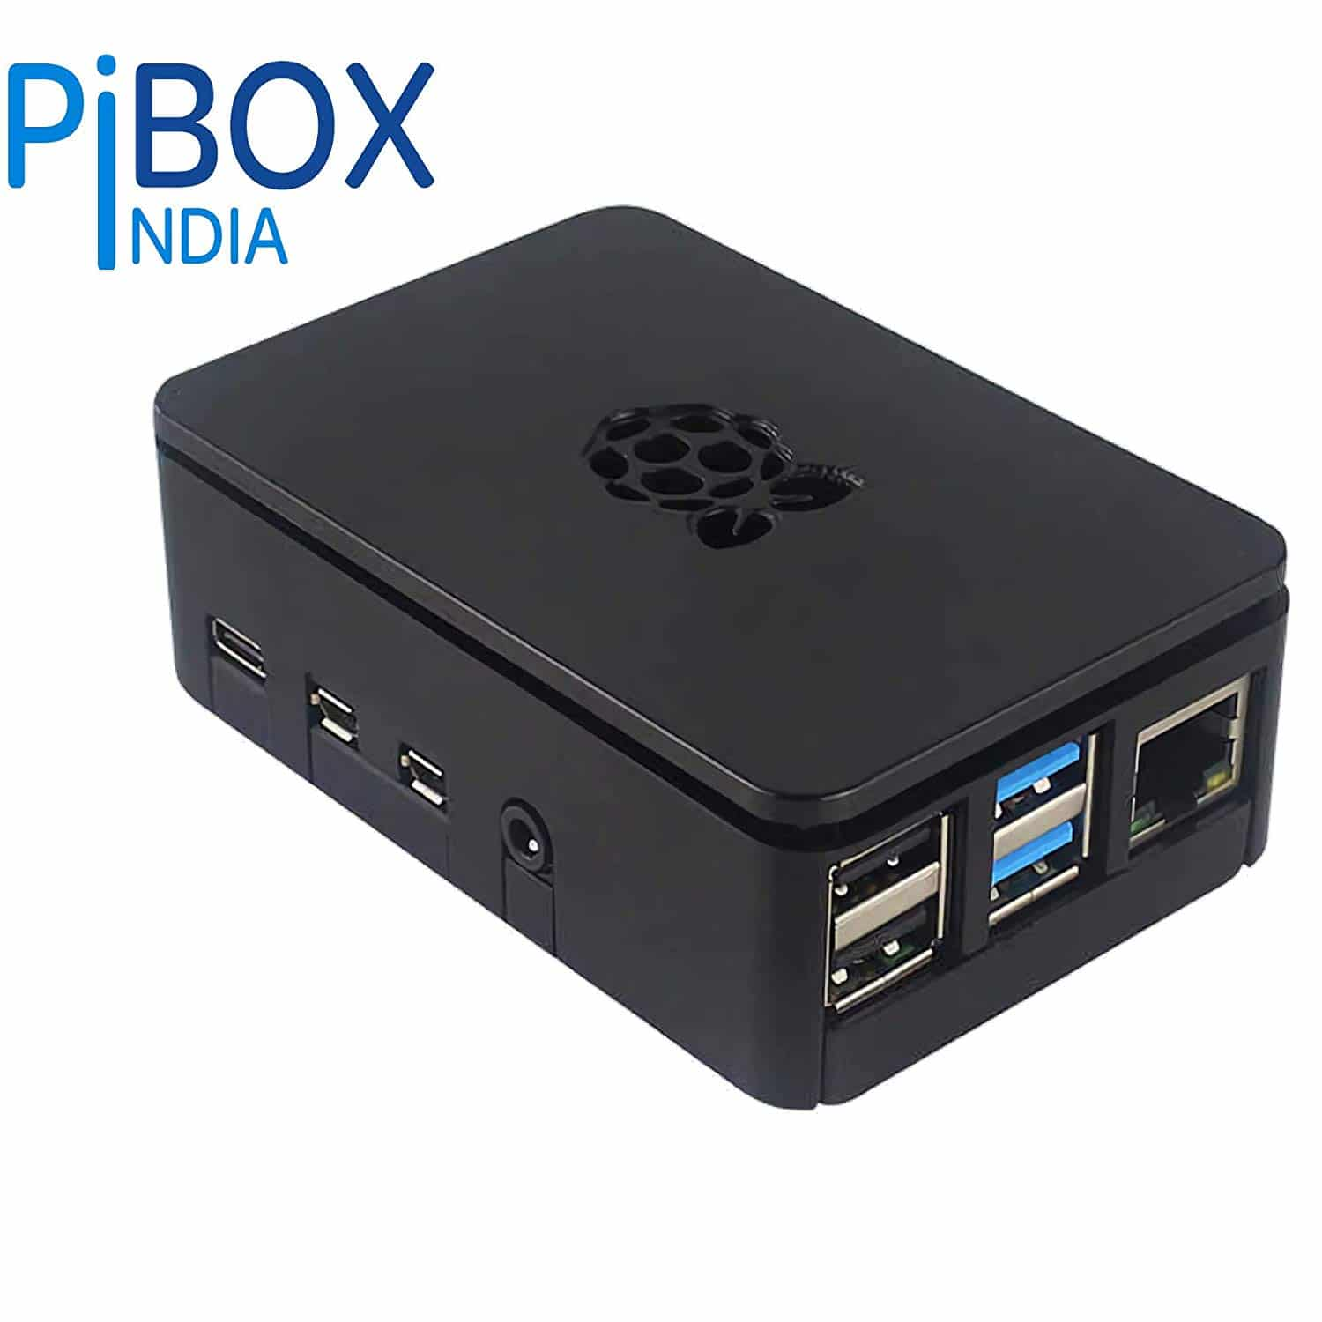
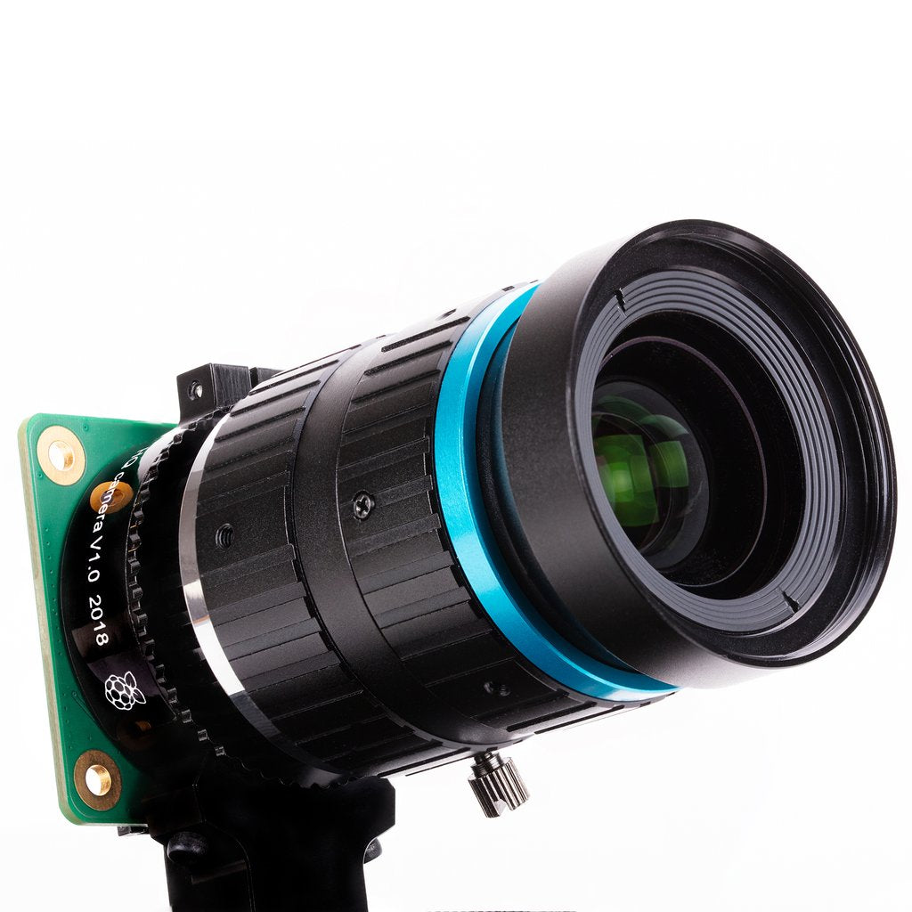
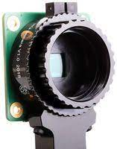
Hardware components

Slide 20
Software components
Amazon S3
Amazon EC2
Amazon DynamoDB
Raspian OS
Python Libraries

Slide 21
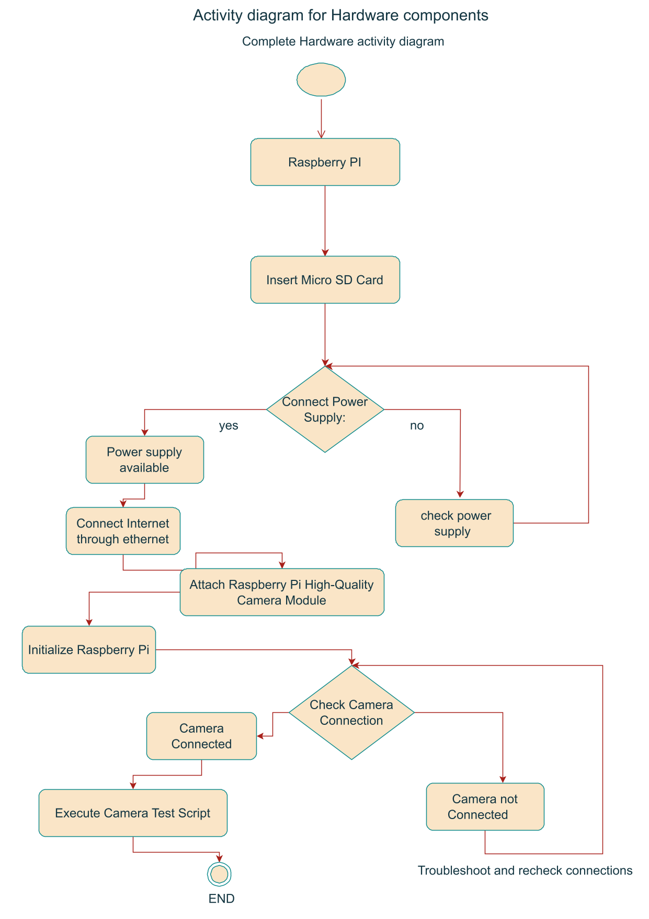
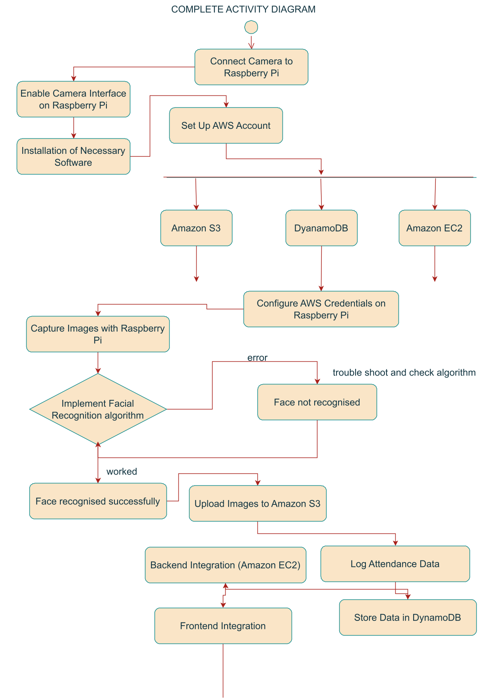
Activity Diagram

Slide 22
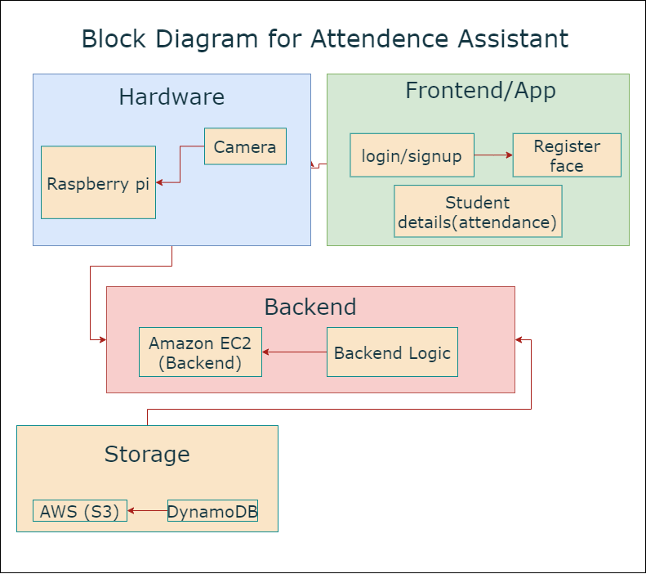
Proposed System Architecture / Block Diagram

Slide 23
Proposed Methodology/ Algorithm
The algorithm for face recognition is yet to be finalized, as a very thorough and comparative analysis of these algorithms is required.
Methodology is explained through the block diagram.

Slide 24
References for Attendance Systems
Nirmalya Kar, Mrinal Kanti Debbarma, Ashim Saha, Dwijen Rudra Pal
Study of Implementing Automated Attendance System Using Face Recognition Technique
Samuel Lukas, Aditya Rama Mitra, Ririn Ikana Desanti, Dion Krisnadi
Student attendance system in classroom using face recognition technique
Akshara Jadhav, Akshay Jadhav, Tushar Ladhe, Krishna Yeolekar
AUTOMATED ATTENDANCE SYSTEM USING FACE RECOGNITION, Dept. of Information Technology, University of Pune, NDMVP’s KBT COLLEGE OF ENGINEERING, NASHIK

Slide 25
References for Raspberry Pi
Dhvani Shah and Vinayak Haradi
IoT Based Biometrics Implementation on Raspberry Pi
L. Arunkumar and A. Arun Raja
Biometrics Authentication Using Raspberry Pi

Slide 26
Thank you!

